Slide 1
Alignment of Shapur I's inscriptions at Naqsh-e Rajab and the Ka'ba-ye Zartosht
Greek – Parthian – Farsi

Slide 2
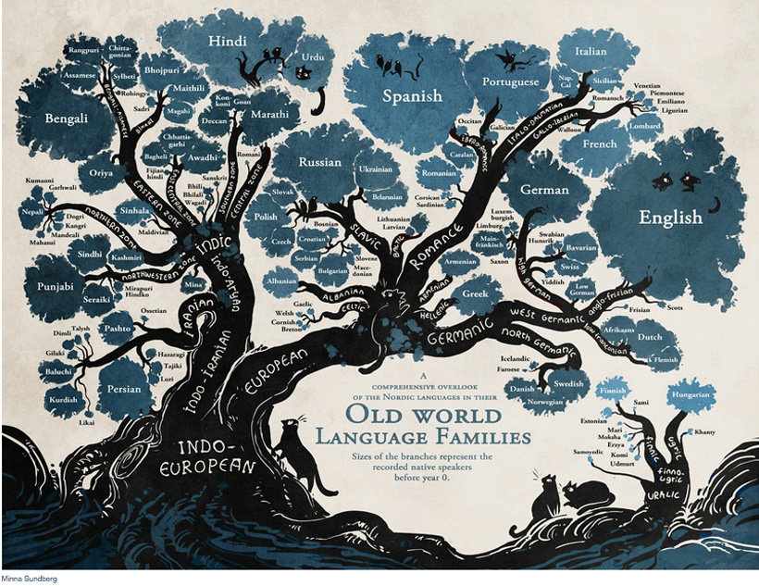

Slide 3
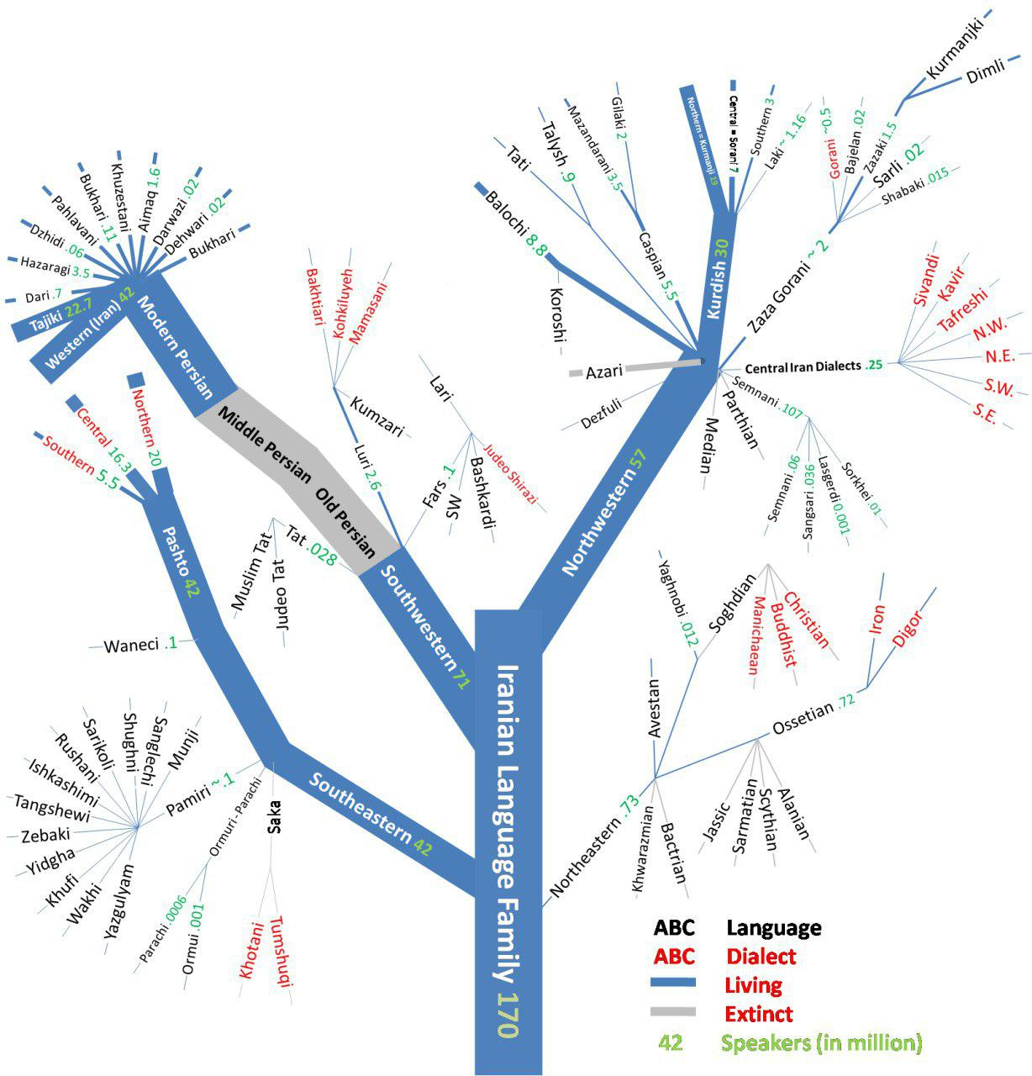
The position of Parthian between Iranian languages
Parthian is a extinct northwestern Middle Iranian language spoken in Parthia, and also the language of state of the Arsacid Parthian Empire (248 BC – 224 AD).
Parthian has been written using two writing systems: Inscriptional Parthian and Manichaean alphabet.

Slide 4
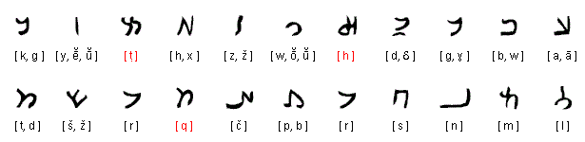
Transcription vs. Transliteration
Parthian Script
A transcription is the conversion of the characters of one language to the characters of another language in accordance with the pronunciation of the target language.
In the transliteration, each character of the source language is assigned to a different character of the target language. If the source language consists of more characters than the target language, combinations of characters and diacritics can be used.

Slide 5
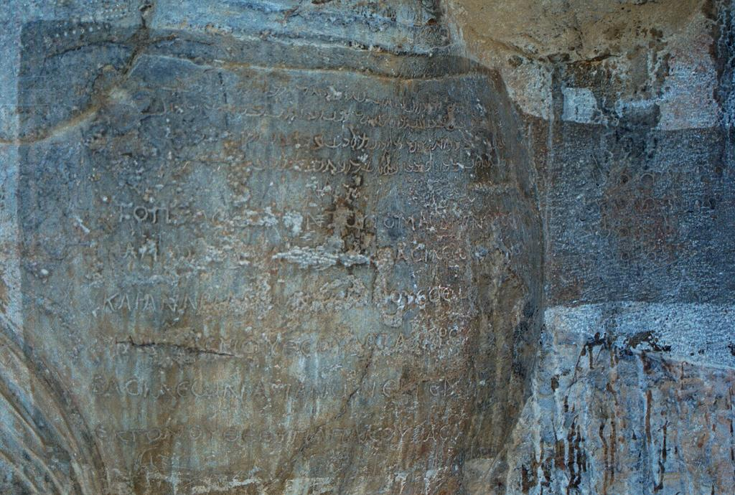
Shapur inscription in Naqsh-e Rajab

Slide 6
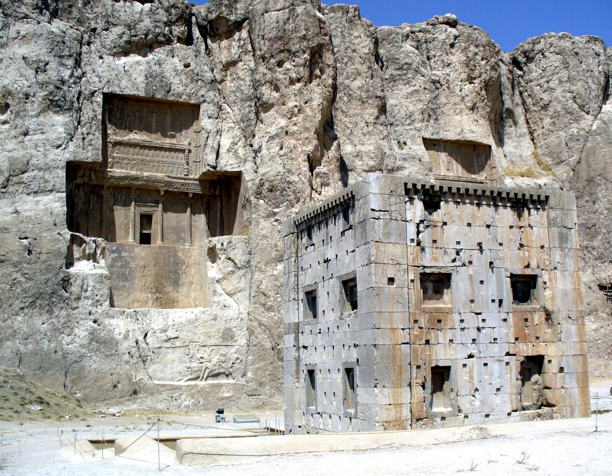
Ka'ba-ye Zartosht in Marvdasht county in Fars, Iran
Ka'ba-ye Zartosht is an ancient building at Naqsh-e Rostam near Persepolis, where the inscription of Shapur I and the priest Karder was found.
Middle Persian version of the inscription of Shapur I (35 lines) is written On the east wall of the building, the Parthian version (30 lines) on the west wall and Greek Version (70 lines) on the south wall.
the Middle Persian inscription of the high priest Karder (KKZ) , which is in 19 lines, is below that of Shapur I on the east wall.

Slide 7
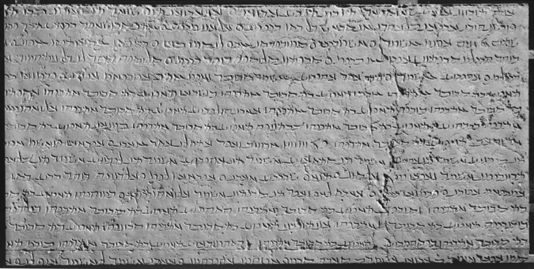
The Parthian version of Shapur I's Ka'ba-ye Zartosht inscription

